Slide 1
Activation functions, Optimization methods, Dropout & Batch norm in NN

Slide 2
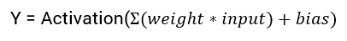
Activation functions
What are activation functions:
Activation functions are an extremely important feature of the artificial neural networks. They basically decide whether a neuron should be activated or not. Whether the information that the neuron is receiving is relevant for the given information or should it be ignored.
The activation function is the non linear transformation that we do over the input signal. This transformed output is then sen to the next layer of neurons as input.
Why activation functions:
When we do not have the activation function the weights and bias would simply do a linear transformation. A linear equation is simple to solve but is limited in its capacity to solve complex problems. A neural network without an activation function is essentially just a linear regression model. The activation function does the non-linear transformation to the input making it capable to learn and perform more complex tasks.

Slide 3
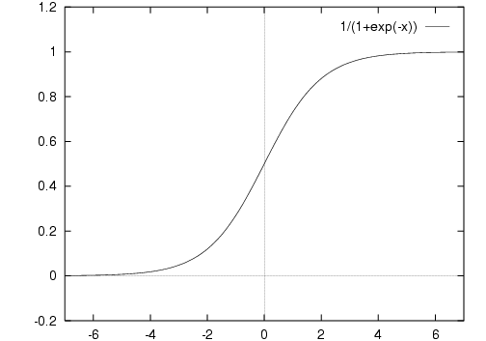
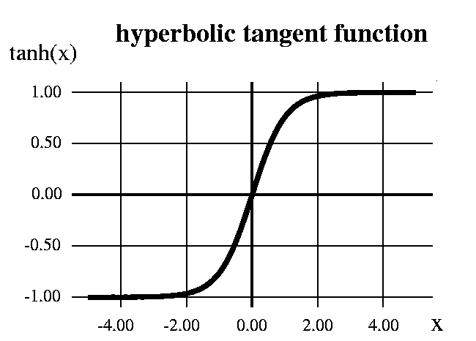
Types of activation functions
Sigmoid: It is a activation function of form f(x) = 1 / 1 + exp(-x) . Its Range is between 0 and 1. It is a S — shaped curve.
CONs:
Vanishing gradient problem : Sigmoids saturate and kill gradients.
its output isn’t zero centered. It makes the gradient updates go too far in different directions and it makes optimization harder. Sigmoids have slow convergence.
Tanh :It’s mathamatical formula is f(x) = 1 — exp(-2x) / 1 + exp(-2x). Now it’s output is zero centered because its range in between -1 to 1 i.e -1 < output < 1 . Hence optimization is easier in this method hence in practice it is always preferred over Sigmoid function . But still it suffers from Vanishing gradient problem.

Slide 4
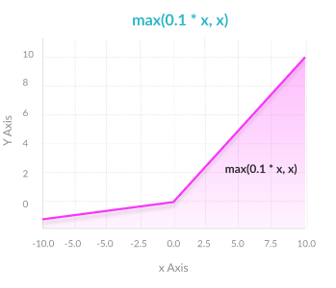
Types of activation functions
ReLu- Rectified Linear units :It’s R(x) = max(0,x) i.e if x < 0 , R(x) = 0 and if x >= 0 , R(x) = x.The range of ReLu is [0, inf). This means it can blow up the activation.
ADVANTAGES
Computationally efficient—allows the network to converge very quickly
Helps with vanishing gradient problem as the gradient is 1 if x is positive and in practice enough of the hidden units will have z>0 , so training will be fast for most of the learning examples.
DISADVANTAGES
The Dying ReLU problem—when inputs approach zero, or are negative, the gradient of the function becomes zero, the network cannot perform backpropagation and cannot learn.
LEAKY RELU
ADVANTAGES
Prevents dying ReLU problem—this variation of ReLU has a small positive slope in the negative area, so it does enable backpropagation, even for negative input values
Why 0.1 ? it can be an learnable param for the network.

Slide 5
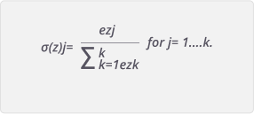
Types of activation functions
Softmax:
ADVANTAGE
Able to handle multiple classes —normalizes the outputs for each class between 0 and 1, and divides by their sum, giving the probability of the input value being in a specific class.
Useful for output neurons—typically Softmax is used only for the output layer, for neural networks that need to classify inputs into multiple categories.

Slide 6
Optimization functions
Gradient descent:
Goes thru enitre training set to make one gradient update, computationally expensive and slow convergence.
Mini Batch Gradient Descent:
Iterates over a mini batch to make one update to the gradient. Faster convergence.
Can implement vectorization to process all the points in the mini batch together.
Stocastic Gradient descent :
Takes only one training example to make one update to the gradient.
We lose the speed we get from vectorization as the mini batch contains only one data point.
Some rough rules :
If data set is small (m<2000): use batch GD
Typical mini batch size are in powers of 2. eg. 2^6, 2^7, 2^9 etc.
Make use the mini batch fits in the cpu/gpu memory.

Slide 7
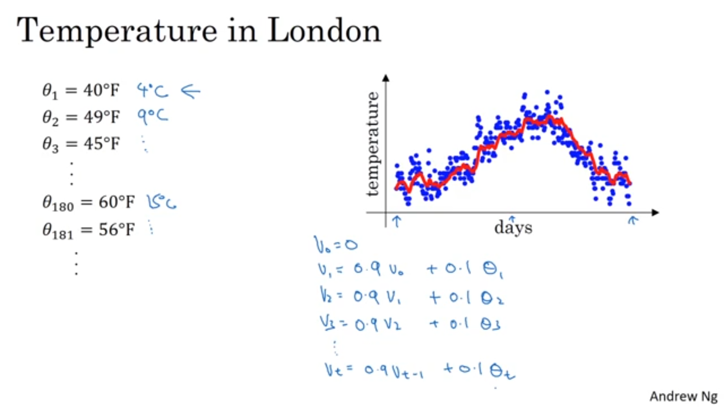
Optimization functions

Slide 8
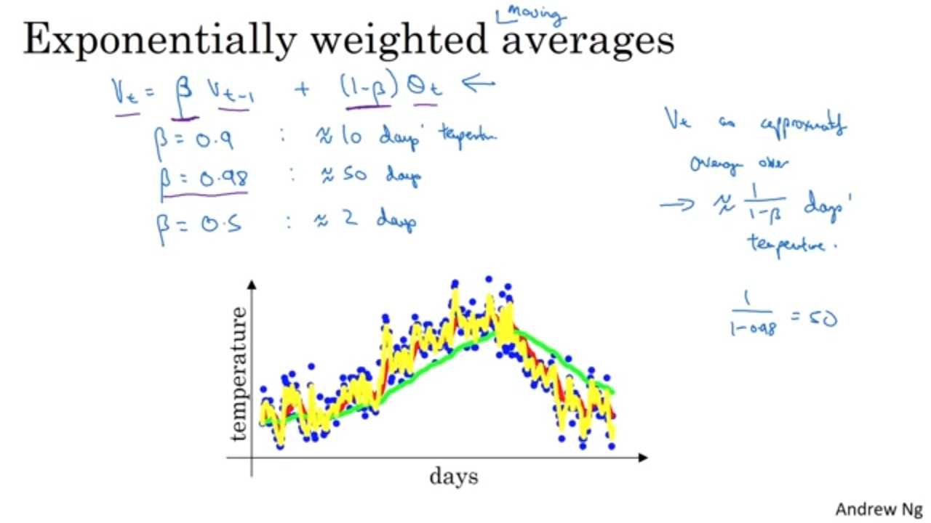
Optimization functions

Slide 9
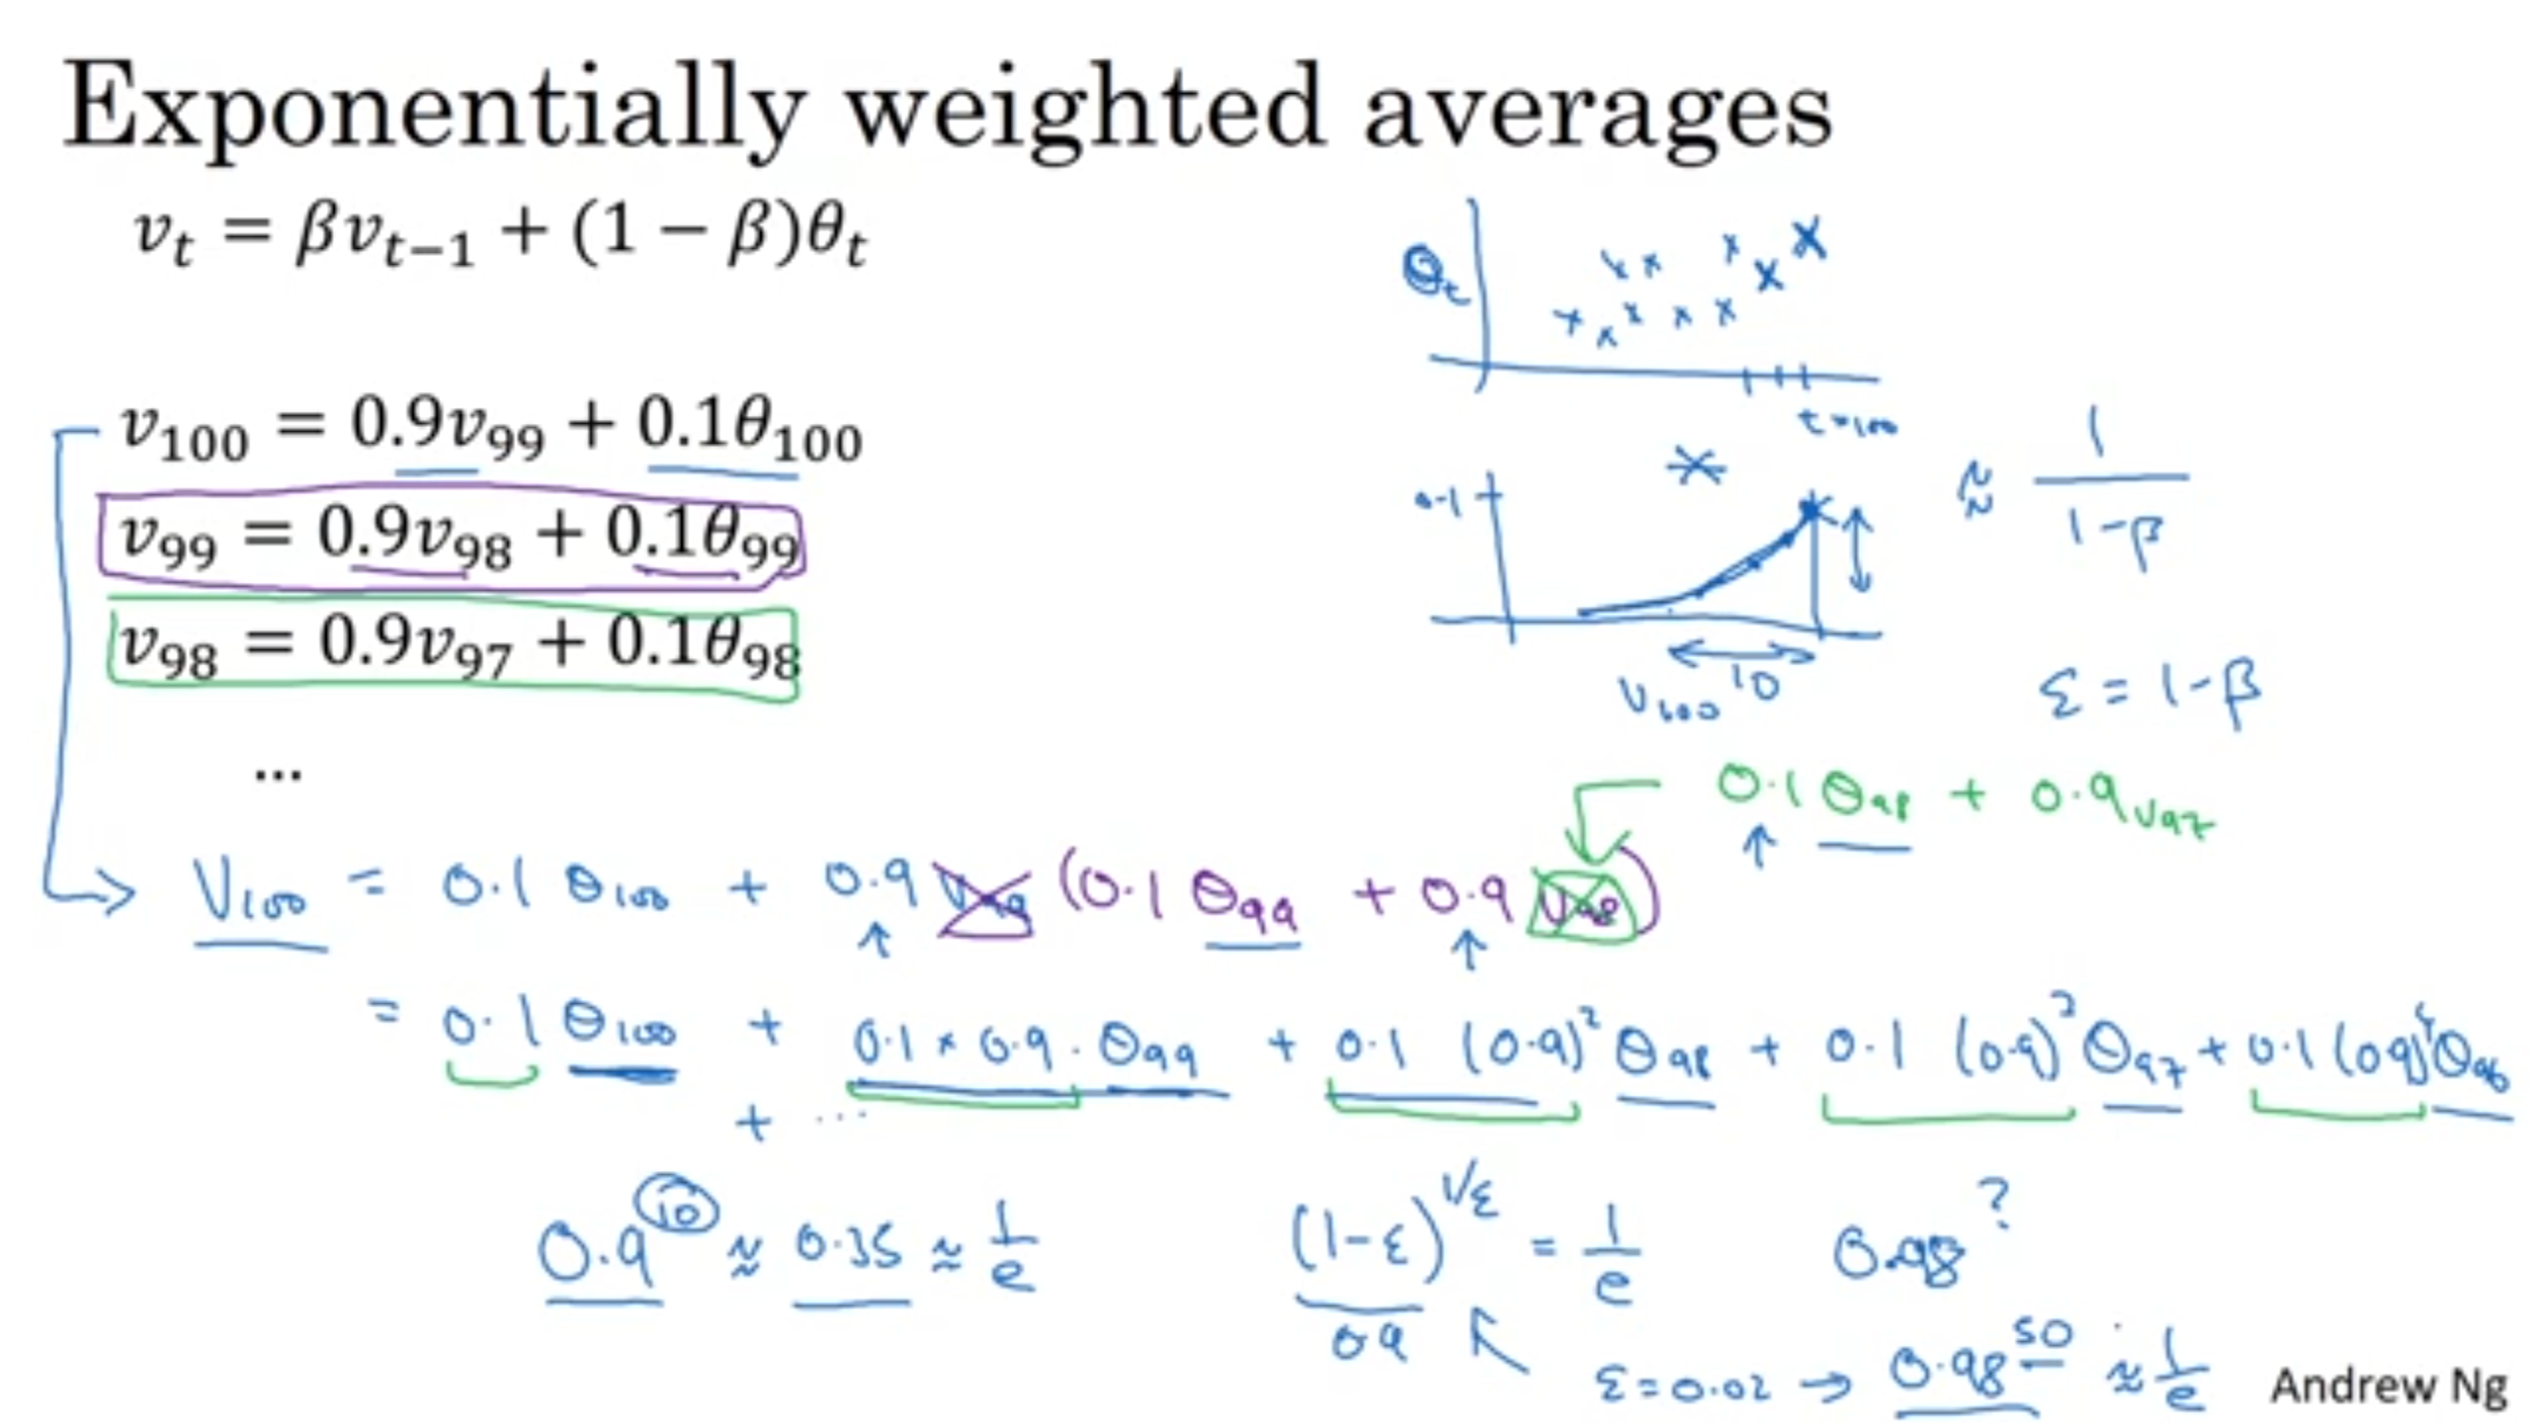
Optimization functions

Slide 10
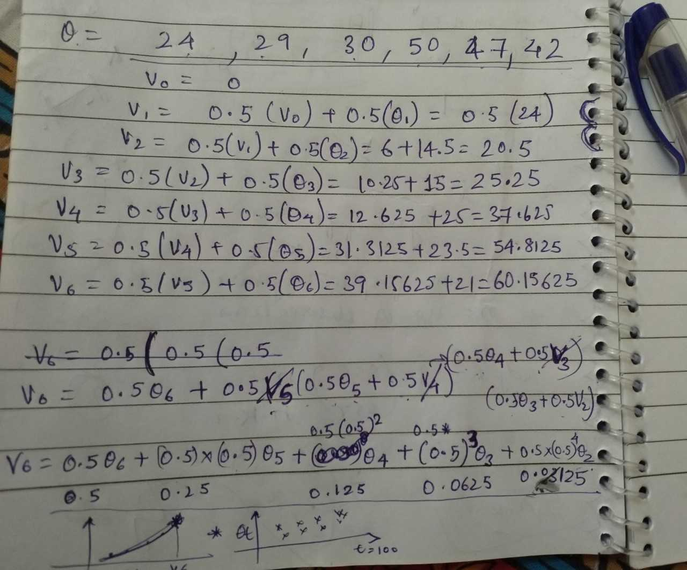

Slide 11
Optimization functions
Implementing Exponentially Weighted Average
Algorithm: Vθ =0 Repeat: {
Get next θt
Vθ := βVθ+(1−β)θt
}
Single line implementation for fast and efficient calculation of exponentially weighted moving average. No need of multiple vars in memory to store all the gradient.

Slide 12
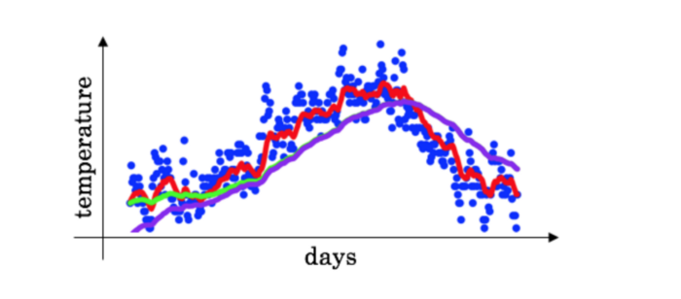
Optimization functions
Bias Correction in Exponentially Weighted Moving Average
Making EWMA more accurate — Since the curve starts from 0, there are not many values to average on in the initial days. Thus, the curve is lower than the correct value initially and then moves in line with expected values.
Figure: The ideal curve should be the GREEN one, but it starts as the PURPLE curve since the values initially are zero
Example: Starting from t=0 and moving forward,
V0 = 0; V1 = 0.98V0+0.02θ1 = 0.20θ1
V2 = 0.98V1 + 0.02θ2 = 0.0196θ1+0.02θ2
The initial values of Vt will be very low which need to be compensated.
Make Vt = Vt/1−β^t
for t=2, 1−β^t= 1−0.98² = 0.0396 (Bias Correction Factor)
V2 = V2/0.0396 = 0.0196θ1 + 0.02θ2 / 0.0396
When t is large, 1/1−β^t =1, hence bias correction factor has no effect when t is sufficiently large.

Slide 13
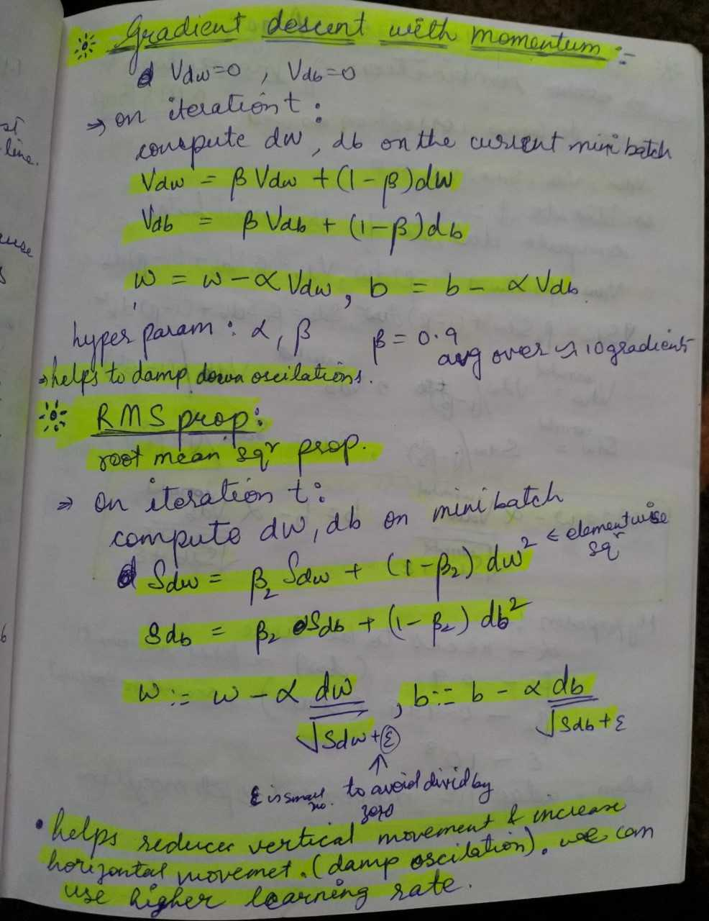
Optimization functions

Slide 14
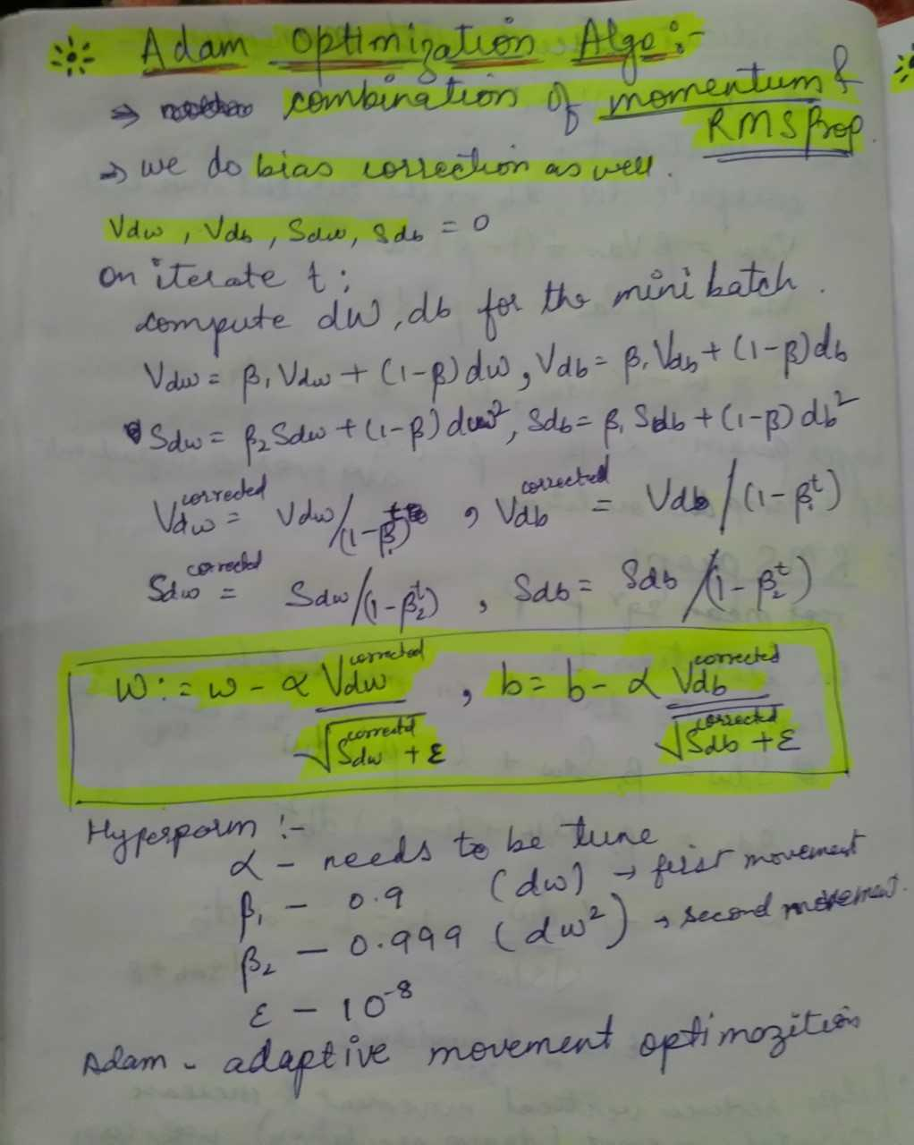

Slide 15
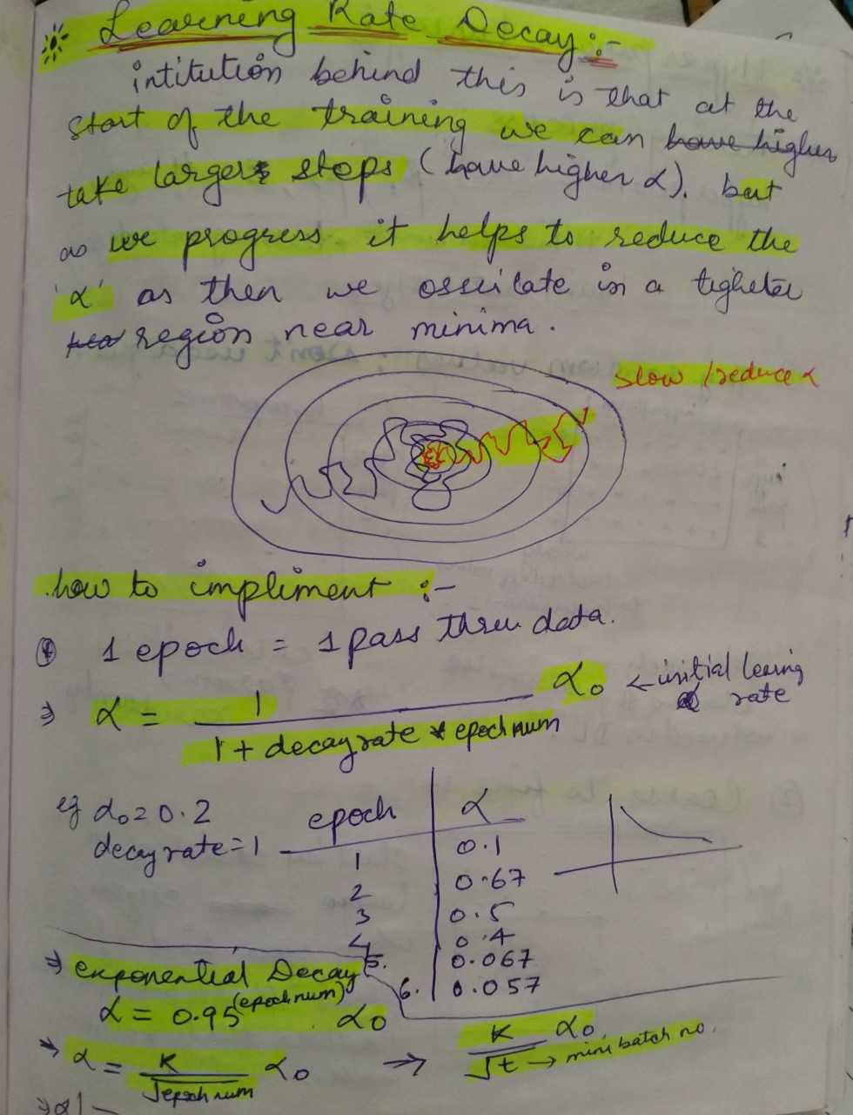

Slide 16
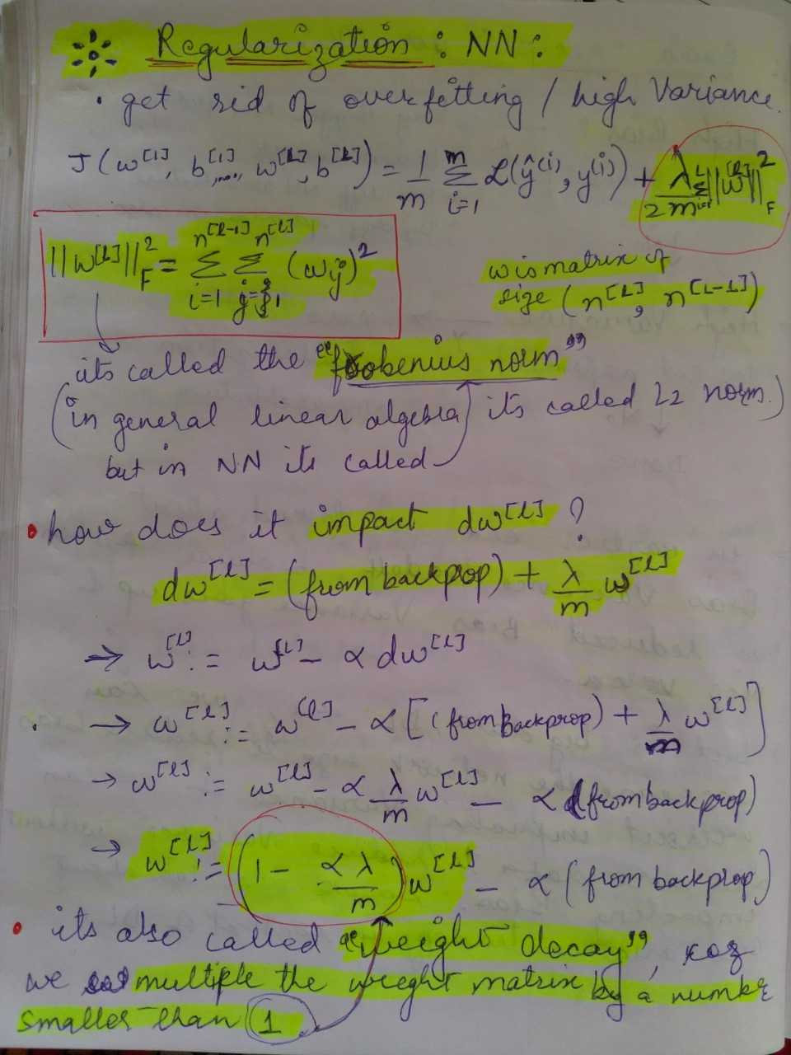
Regularization in NN

Slide 17
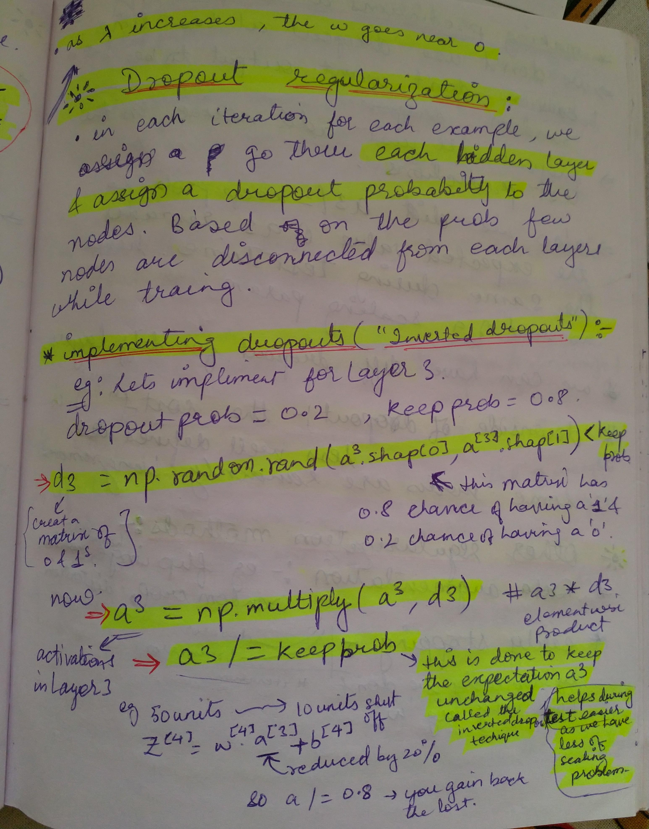

Slide 18


Slide 19
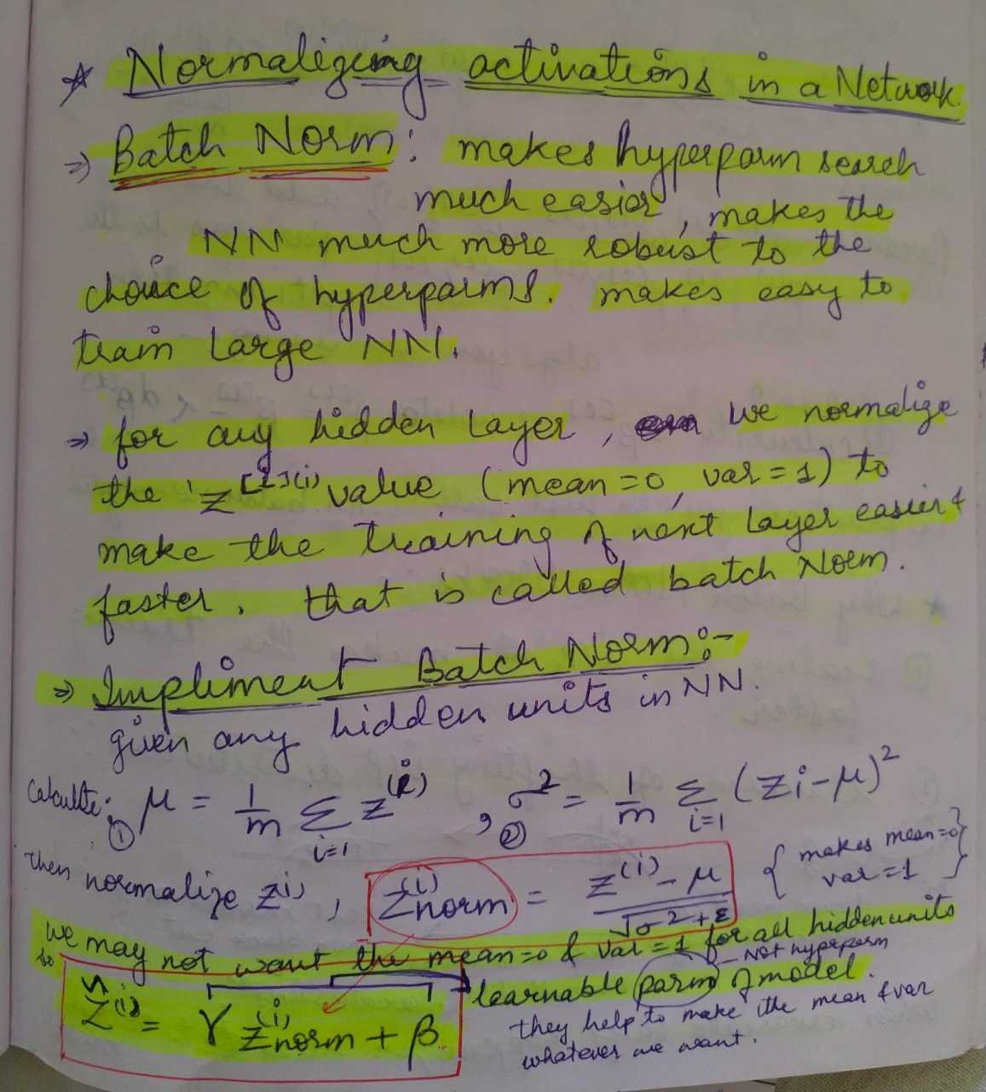

Slide 20
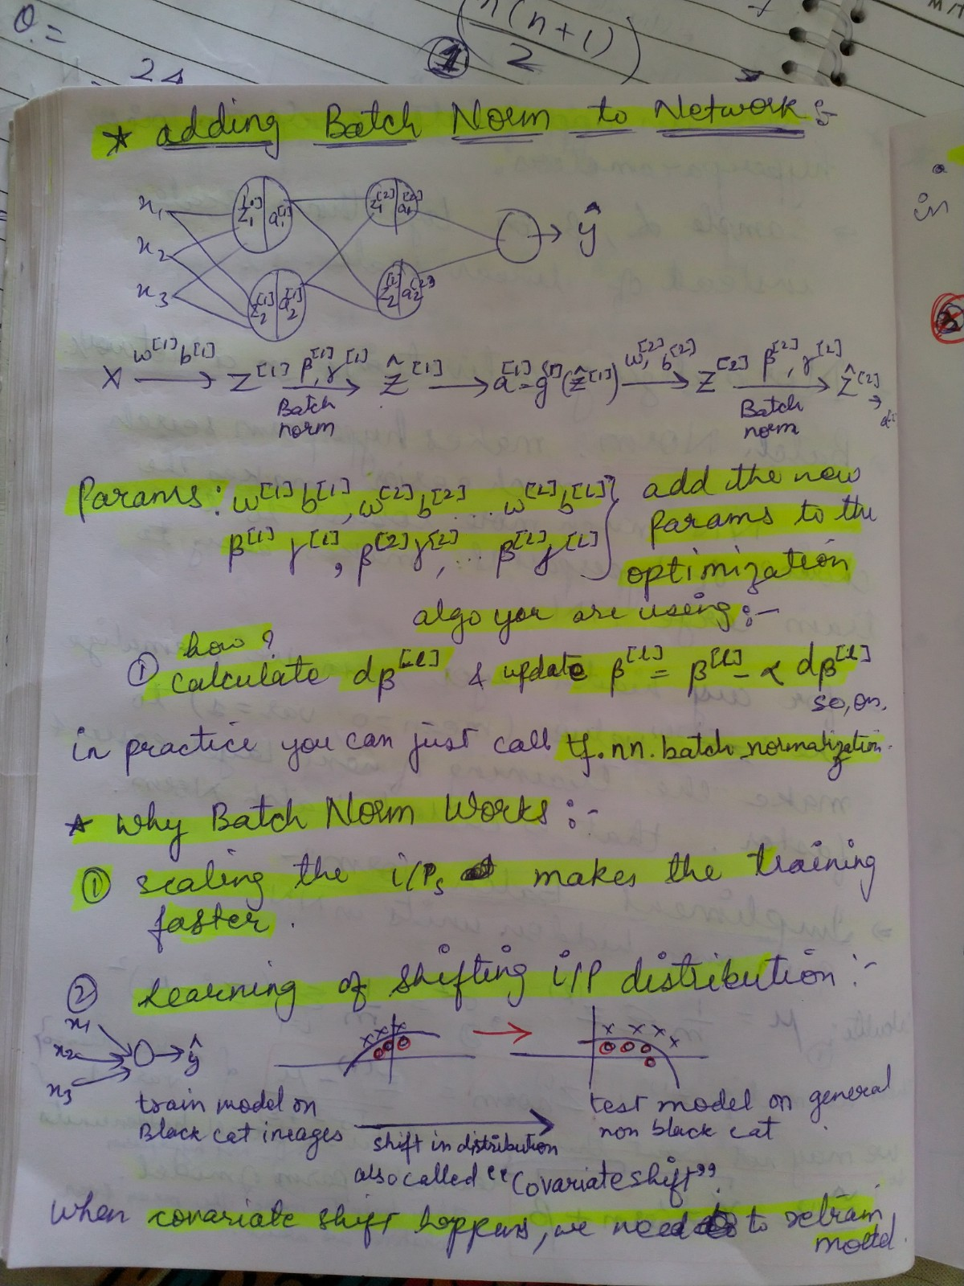

Slide 21


Slide 22
